Slide 1
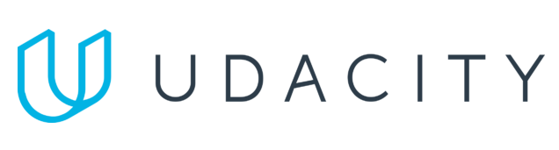
Data Lake Value Proposition
Medical Data Processing Company
Duy Le Khanh
Udacity IPS Version 1.0

Slide 2
Agenda
What is a Data Lake
Components of a Data Lake
Data Lake vs Data Warehouse
Business Value of Data Lake Solution
Proposed Data Lake Architecture for Medical Data Processing system
Udacity IPS Ver. 1 2/2020

Slide 3
What is a Data Lake
Executive summary
A Data Lake is a centralized repository that allows you to store structured, semi-structured, and unstructured data at any scale. Unlike a traditional data warehouse, a data lake enables real-time data ingestion and is designed to handle a variety of data formats, making it a flexible solution for modern businesses. It facilitates scalable data storage and provides powerful processing and analytics capabilities for enterprises.

Slide 4
Components of Data Lake
Data Ingestion Layer
The data ingestion layer is responsible for collecting data from multiple sources including real-time streams, batch uploads, and APIs. Common tools include Apache Kafka, AWS Glue, or Apache NiFi.
Data Storage Layer
A scalable and cost-effective storage solution like Amazon S3, Azure Data Lake, or Hadoop Distributed File System (HDFS) stores raw and processed data, enabling access across the enterprise.
Data Processing Layer
The processing layer allows ETL (Extract, Transform, Load) operations using tools like Apache Spark, Databricks, or AWS EMR. It helps to prepare data for downstream analytics and machine learning models.
Serving layer
The serving layer in a Data Lake architecture provides access to processed data for various applications like machine learning models, business intelligence (BI) tools, and dashboards. It ensures efficient querying of both structured and unstructured data, enables integration with external applications via APIs, and supports real-time data streams for immediate insights

Slide 5
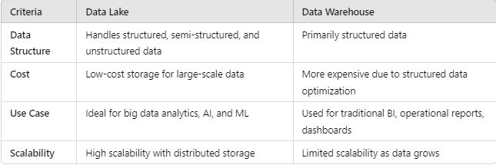
Data Lake vs Data Warehouse

Slide 6
Why Data Lake Makes Sense for Medical Data Processing?
Flexibility: Medical data often comes in unstructured forms (text notes, images, etc.), which a data warehouse cannot handle effectively.
Scalability: A data lake can store petabytes of data, making it ideal for medical data that grows exponentially.
Advanced Analytics: Enables AI/ML models that require vast amounts of varied data, which is crucial in the medical field.

Slide 7
Business Value of Data Lake
Improved Decision-Making
With all data in a single repository, the company can apply advanced analytics and machine learning to extract insights that inform medical innovations and operational improvements.
Cost Efficiency
A Data Lake offers low-cost storage for vast amounts of data, making it ideal for long-term retention of large datasets without incurring high infrastructure costs.
Scalable Data Processing
Enables real-time processing and analysis of medical data, enhancing patient outcomes and optimizing research operations.
Enhanced Data Security and Compliance
A Data Lake provides robust security features like data encryption, access control, and user authentication, ensuring that sensitive medical data is stored securely. These security mechanisms help the company maintain compliance with healthcare regulations such as HIPAA and GDPR, protecting patient privacy and reducing the risk of data breaches. By implementing a secure data lake, the company can ensure that all regulatory requirements are met, avoiding potential fines and maintaining trust with clients and patients.

Slide 8
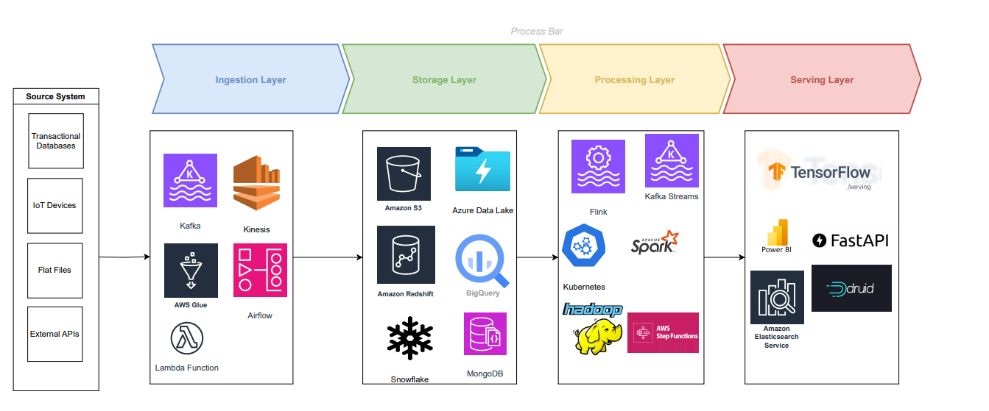
Data Lake Architecture

Slide 9
THANK YOU
Udacity IPS Version 1.0

